Slide 1
National Wealth Distribution Platform
Making your life easier

Slide 2
Do you Know?
There'll be a million over-65s in Ireland by 2031
Source: https://www.thejournal.ie/older-people-ireland-3-2963935-Sep2016/
Our MottO
Create a financial assistance platform for the ageing population

Slide 3

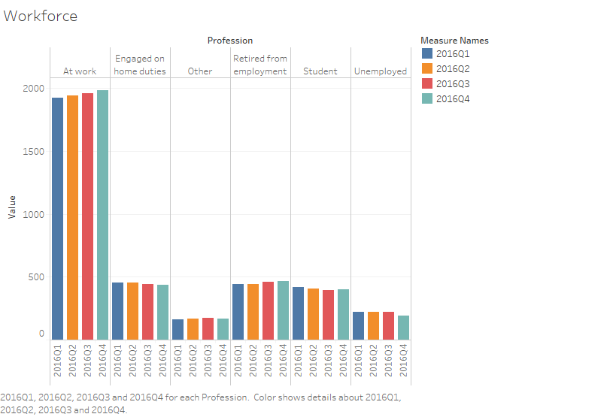
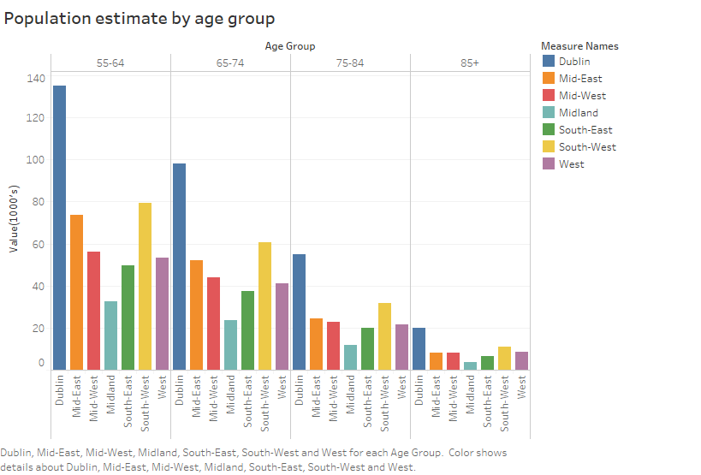
Insights From AVAILABLE DATASETS
Source:
https://www.cso.ie/px/pxeirestat/statire/SelectVarVal/Define.asp?Maintable=QNQ33&Planguage=0
https://health.gov.ie/publications-research/statistics/statistics-by-topic/demographics/

Slide 4
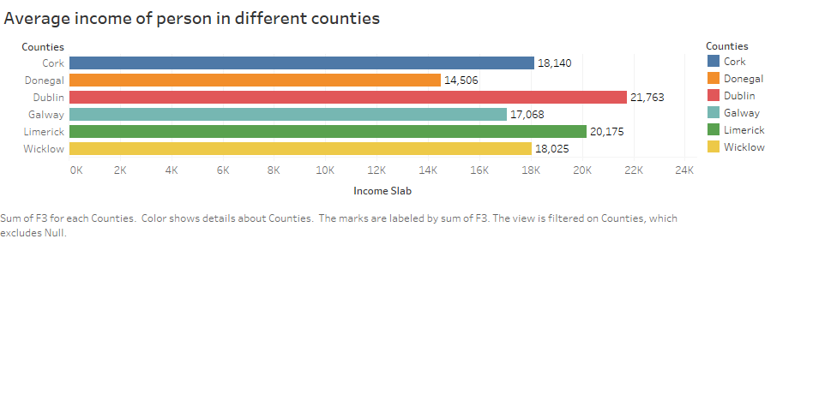
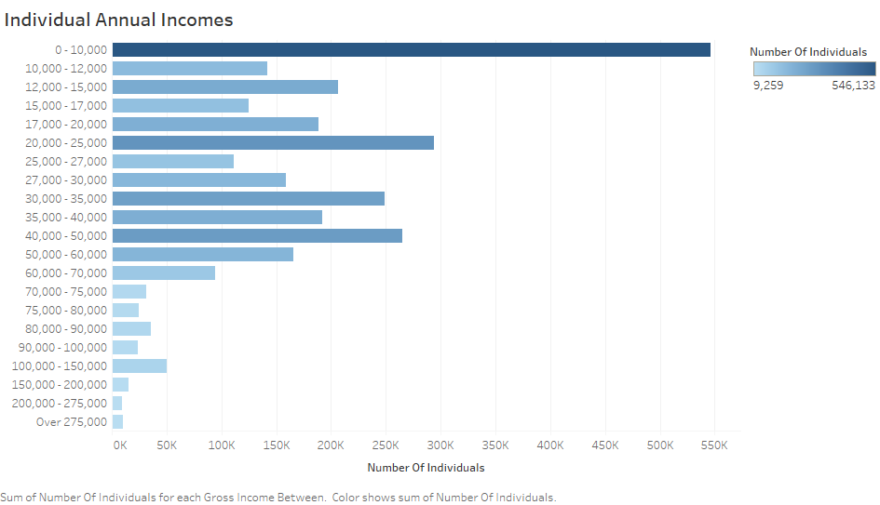
Insights From AVAILABLE DATASETS(Contd.)
Source:
https://data.gov.ie/dataset/individualised-gross-income-distributions

Slide 5
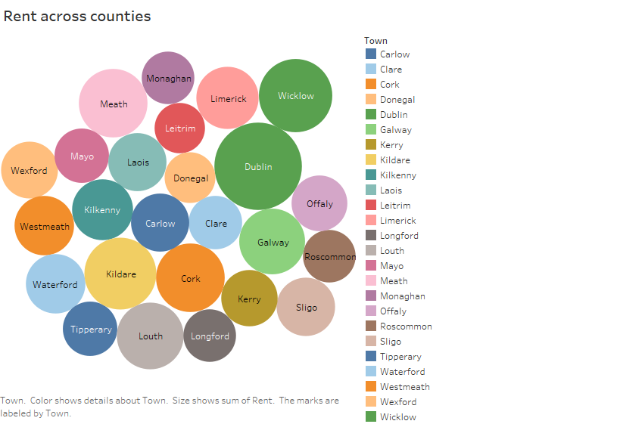
Insights From AVAILABLE DATASETS(Contd)
Source:
https://data.gov.ie/dataset/rtb-average-monthly-rent-report-euro-by-year-location-property-type-and-number-of-bedrooms

Slide 6
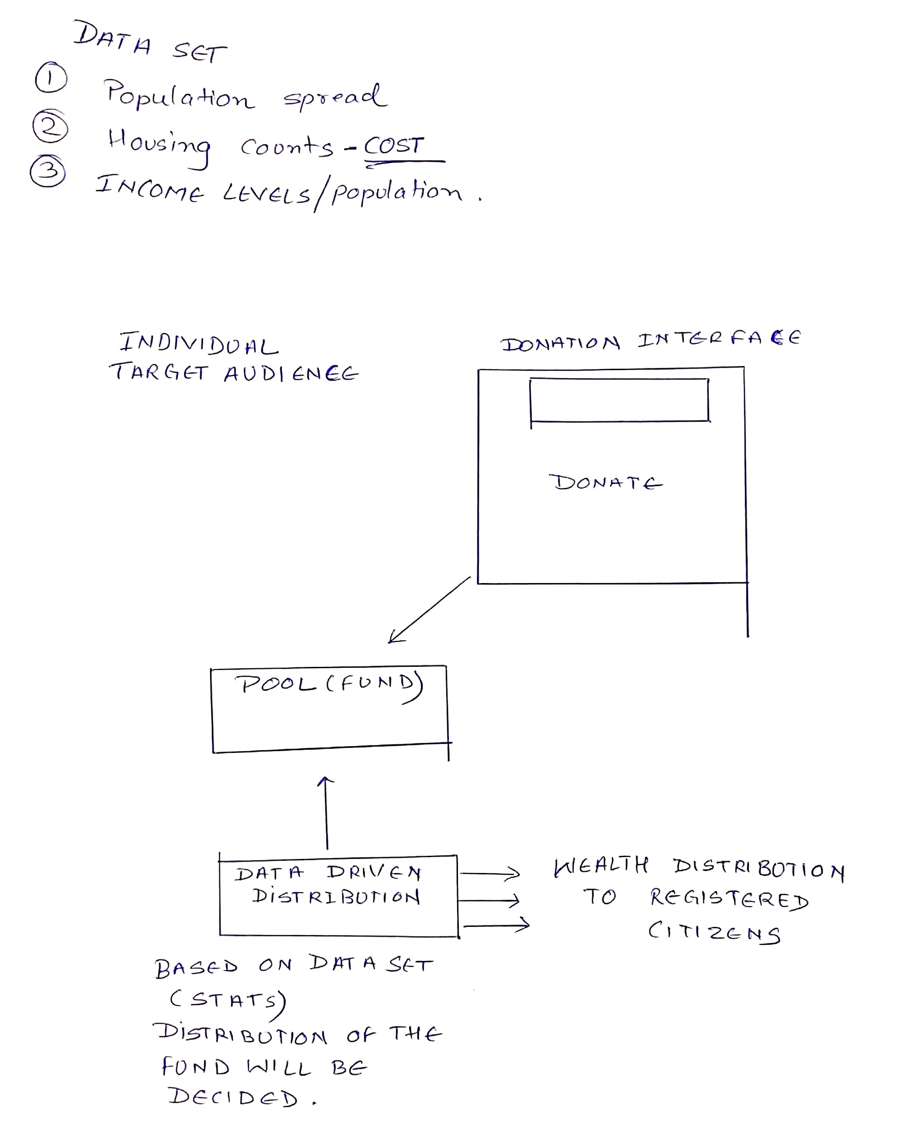
BrainStorming

Slide 7



Solution FrameWork

Slide 8
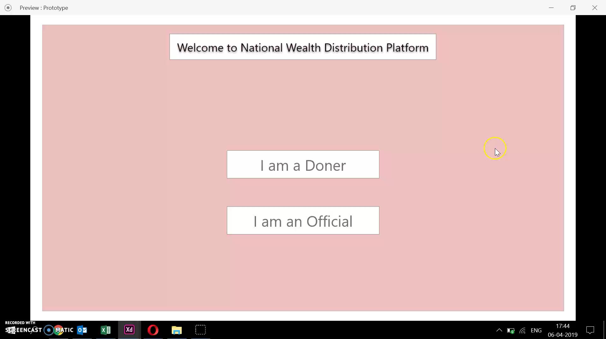
Prototype

Slide 9
Future possibilities
Rolled out for low income people
Rolled out for homeless people
Rolled out for unemployed people

